Slide 1
Version Control
Git & Github

Slide 2
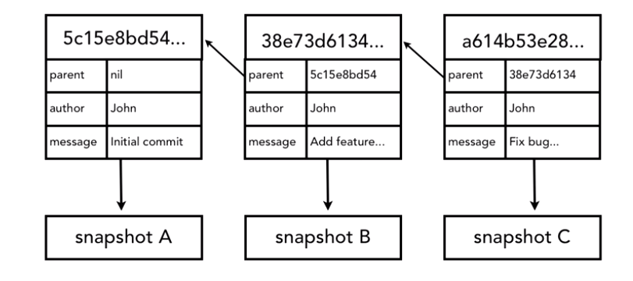
How GIT manages and stores commits?
Every change set that is committed is converted to a checksum using SHA-1 hash algorithm
SHA id is 40 character hexadecimal string

Slide 3
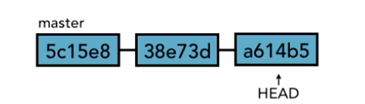
HEAD Pointer points to the tip of the current branch on repository

Slide 4
Git Diff
The git diff command is a useful tool in Git to view the differences between various states of your repository.
Let’s Setup a new Repository:
Create Directory: mkdir demo
Move to the directory: cd demo
Initialize a Git repository: git init

Slide 5
Git Diff
Edit the file: echo "Added new line" >> file.txt
See the difference: git diff
It shows changes in the working directory compared to the last committed version.
Added lines are prefixed with +
removed lines are prefixed with –

Slide 6
Staged Changes
Stage the changes: git add file.txt
View differences between the staged version and the last commit:
git diff --cached
Displays changes between the staging area (index) and the last commit.

Slide 7
Compare Different Commits
Commit the staged changes
git commit -m "Added a new line"
Make further changes
echo "Another change" >> file.txt
git add file.txt
git commit -m "Added another change"
View differences between two specific commits
git diff <commit1> <commit2>

Slide 8
Git Diff Flags
Ignore Whitespace Changes:
git diff --ignore-all-space
Show Differences for a Specific File:
git diff file.txt
You can also compare 2 different branches:
git diff branch1 branch2

Slide 9
Rename
Rename:
git mv <old-filename> <new-filename>
If you renamed a file accidentally, you can revert before committing:
git restore --staged old_filename new_filename
After committing, you can view renames in the diff:
git diff --find-renames

Slide 10
Undo Changes
Undoing changes to staged files:
git reset HEAD <filename>
Undoing a commit: If you have already committed changes and want to undo the last commit
This will undo the last commit but leave your changes staged.
Completely discarding all local changes:
git reset --hard HEAD
git reset --soft HEAD^

Slide 11
Revert
If you have already pushed changes to a remote repository and want to revert a commit, you can use:
git revert <commit-hash>
This will create a new commit that undoes the changes introduced by the specified commit.

Slide 12
Show Commit History
Git log: show all commits
To exit from many commit you can press q
git log -n 5: This will show the last 5 commits in your repository's history.
Search within git log:
git log --grep="search-term"
Git log in one line: git log –oneline
Git show: showing details of commit

Slide 13
Branching
Create one folder for understanding the branch concepts
mkdir git-branching-demo
cd git-branching-demo
git init
Create a file
echo "This is the main branch." > app.txt
Stage and commit the file
git add app.txt
git commit -m "Initial commit: Add main branch content“
git branch add-login
git checkout –b add-login
You can also create and switch in one command
git switch -c add-login

Slide 14
Branching
Verify Branch
git branch
The active branch will be highlighted with *.
Make Some chnages into new Branch:
echo "Feature: Add user login functionality." >> app.txt
Stage and commit the changes
git add app.txt
git commit -m "Add login feature“
Switch back to main Branch:
git checkout main
Verify the file:
cat app.txt

Slide 15
Merging
Switch to the main branch
git checkout main
Merge the feature branch
git merge add-login
Verify the file:
cat app.txt
Delete the Branch:
git branch -d add-login

Slide 16
Some More
Create and switch to a bug-fix branch
git checkout -b fix-login-bug
Make changes
echo "Fix: Correct login functionality." >> app.txt
Stage and commit the fix
git add app.txt
git commit -m "Fix login bug"
Merge back into main
git checkout main
git merge fix-login-bug
Delete the bug-fix branch
git branch -d fix-login-bug

Slide 17
Example
Create a new branch named 'feature/new-feature' and switch to it
git checkout -b feature/new-feature
Make changes to your code and commit them on the 'feature/new-feature' branch
git add .
git commit -m "Added new feature"
Switch back to the main branch
git checkout main
Compare tips of two branches (main and feature/new-feature)
git diff main feature/new-feature
View all branches (local and remote)
git branch -a
View HEAD pointers of all branches
git show-ref
Merge 'feature/new-feature' branch into 'main' (assuming no conflicts)
git merge feature/new-feature
Delete the 'feature/new-feature' branch after merge
git branch -d feature/new-feature

Slide 18
True Merge
Assume you have diverged branches: main and feature/branch-b.
Create a new branch and make changes:
git checkout -b feature/branch-b
Make changes to files and commit them
git add .
git commit -m "Made changes in feature branch“
Switch back to main and merge:
git checkout main
git merge feature/branch-b
If there are new commits on both main and feature/branch-b, Git performs a true merge, creating a new commit that combines changes from both branches.

Slide 19
Aborting a Merge:
Start the merge:
git merge feature/branch-b
Here, you have encounter some conflicts and decide to abort for other reasons.
git merge --abort

Slide 20
Resolving Conflict Manually:
Create and switch to a new branch (feature/branch-c):
git checkout -b feature/branch-c
Make changes to file.txt and commit them
echo "Feature branch content" > file.txt
git add file.txt
git commit -m "Made changes in feature branch"
Switch back to main and make conflicting changes:
git checkout main
Make conflicting changes to file.txt and commit them
echo "Main branch content" > file.txt
git add file.txt
git commit -m "Made changes in main branch"

Slide 21
Merge feature/branch-c into main, causing conflicts:
git merge feature/branch-c
Git will detect that file.txt has conflicting changes in both branches and will output a message indicating a merge conflict.
Decide which changes to keep or modify file.txt accordingly.
Feature branch content and Main branch content combined (modify it manually)
Stage the resolved file and commit the merge:
git add file.txt
git commit

Slide 22
Tagging
tags are used to mark specific points in the repository's history, such as releases or significant commits.
There are two types of tags:
lightweight tags
annotated tags.

Slide 23
Lightweight Tags
A lightweight tag is simply a pointer to a specific commit. It's similar to a branch that doesn't change — it's just a reference to a commit.
git tag <tag-name>
E.g. git tag v1.0.0

Slide 24
Annotated Tags:
An annotated tag, on the other hand, is stored as a full object in the Git database.
It includes a tagger name, email, date, and a tagging message.
Annotated tags are recommended for most use cases as they provide more information and context about the tag.
git tag -a <tag-name> -m "Tagging message"
E.g. git tag -a v1.0.0 -m "Initial release version 1.0.0"

Slide 25
Viewing Tags:
To view all tags in the repository:
Git tag
View details of specific tag:
git show <tag-name>

Slide 26
Pushing Tags:
Tags created locally are not automatically pushed to remote repositories.
To push tags to a remote repository:
git push origin <tag-name>
To push all tags to the remote repository:
git push origin --tags

Slide 27
Deleting Tags:
To delete a tag locally:
git tag -d <tag-name>
To delete a tag from the remote repository (after it has been pushed):
git push origin --delete <tag-name>

Slide 28
Remotes – Create repository on Github
Create a new repository on Github
Copy the URL of the new repository
Clone the repository on your laptop.
Create two repositories on local
git clone <URL> GITLab1
git clone <URL> GITLab2

Slide 29
Tags With Real scenario
You are working on a project and want to tag significant milestones, such as "v1.0" for the first release and "v1.1" for an update.
Create folder, move to it and initialize git repo.
Create a file, stage and commit.
Create light weight tag: git tag v1.0
Verify tag: git tag
You can also create annotated tags because they include metadata such as the author, date, and a message.
git tag -a v1.0 -m "First release version 1.0“
Verify: git show v1.0
Push Tags: git push origin v1.0
Make changes to the existing file, stage and commit.

Slide 30
Tags With Real scenario
Create Tag version: git tag -a v1.1 -m "Second release version 1.1“
See all tags: git tag
If you want to tag some older commit then:
git tag -a v0.9 hash-code -m "Tag for pre-release version 0.9“
Delete locally
git tag -d v0.9
Delete from remote (if already pushed)
git push origin --delete v0.9

Slide 31
Key Takeaways
A tag always points to a specific commit.
If you commit first and then add a tag, the tag will be associated with the commit you just made.
Tags are useful for marking specific points in your repository's history, like releases or milestones.

Slide 32
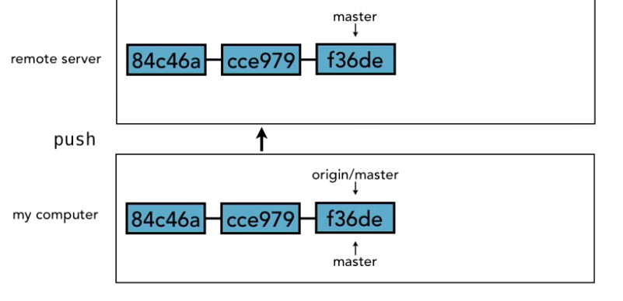
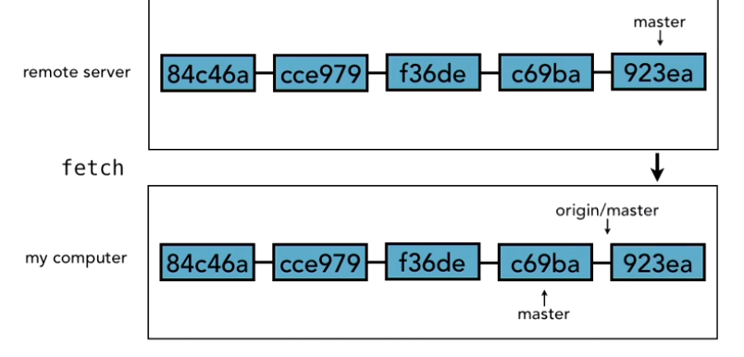
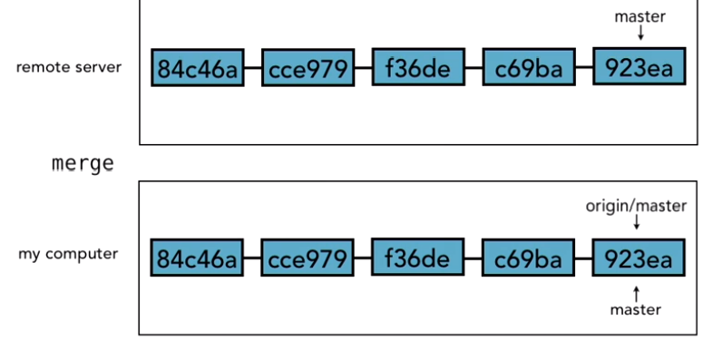
Working with remotes

Slide 33
Tracking and non tracking branch
Push –u always creates a tracking branch that tells GIT about the remote details.
Without –u, push will send changes to remote without creating a tracking branch to sync changes
Clone automatically creates a tracking branch

Slide 34
Pushing / Fetching changes to/from Remote
Pushing changes to remote: git push
Viewing tracking branch: git branch -vv
Viewing changes on Remote:
git fetch origin (Fetches the latest changes from the remote repository)
git branch –r (view remote branch)
Push a new local branch to remote:
git checkout -b new-branch-name (Creates a new branch named new-branch-name and switches to it.)
git push -u origin <local-branch-name>

Slide 35
Push Code to Remote Repository
Using Browser Authentication
Using SSH

Slide 36
Use SSH
Generating Key
ssh-keygen -t rsa -b 4096 -C "sonam.gravity@gmail.com"
starting agent in the background
eval $(ssh-agent -s)
set up private key ass ssh-client
ssh-add ~/.ssh/id_rsa
it will ask you to enter passphrase. copy public key for adding it to GitHub
clip < ~/.ssh/id_rsa.pub
GitHub --> settings --> SSH & GPG key --> add new SSH key and paste the copied key
Once its configured you can set origin with ssh command rather that using https and that it.
You can push code on GitHub directly using ssh.
so your origin setup look like this: git remote add origin git@github.com:sonam-niit/TestSSH.git

Slide 37
Assignment 1

